Slide 1
Practice Lab:
This Practice Lab is dependent on Discussion Unit 7548, where most of the objects we create in this lab were introduced.
In this Practice Lab, we migrate a number of [ your ] DSE Spark Scala statements (runnable in the Scala REPL, created in Practice Lab 7545), to a true Scala/Spark program.
DSE Scala REPL to Scala Program
Notes:
The goal of this Practice Lab is to create, compile, and execute a DSE Spark Scala program. Presumably, the statements in this program were first developed and tested using the DSE Scala REPL.
Discussion Unit 7548 outlines most (all ?) of the artifacts that need to be created in detail.

Slide 2
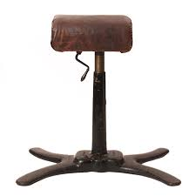
Challenge 1: Prerequisites
Prerequisites:
Instructions are provided for Linux
We will operate below recommended settings; 1 OS node only, minimum 8 GB RAM, 12 GB RAM preferred
That you have an operating single node DSE Core cluster with DSE Analytics enabled.
All work done as ‘root’
Notes:
To complete this Practice Lab, the following is assumed:
All prerequisites and conditions as listed above.
All work is expected to be executed on one OS node (instructions are written for Linux).
Because of resource constraints, it is expected you are running a single DSE Core node (no Graph, yes Analytics/Spark, no Search) on this single OS node.

Slide 3


Challenge 1: Prerequisites
Confirm or install the Scala compiler, as outlined in Discussion Unit 7548.
Confirm or install the Maven utility, as outlined in Discussion Unit 7548.
Notes:
Confirm the presence of or install; Scala, Maven
Instructions are given in Discussion Unit 7548.

Slide 4

Challenge 1: Scala REPL to Scala Program
cd /opt (cd anywhere)
mvn archetype:generate \
-DgroupId=com.datastax.enablement.bootcamp \
-DartifactId=my-app \
-Dversion=1.0 \
-DinteractiveMode=false \
-DarchetypeArtifactId=scala-archetype-simple \
-DarchetypeGroupId=org.scala-tools.archetypes \
-DremoteRepositories=http://scala-tools.org/repo-releases
cd my-app
rm -r ./src/test/scala/samples/*
Generated tests: Will error on compile unless corrected
Notes:
Also using instructions from Discussion Unit 7548:
Generate the project structure using, "mvn generate ... " (as shown)
Delete the contents under the test folder, as shown
These steps are only executed one time.

Slide 5
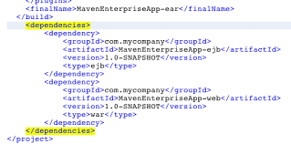
Challenge 1: Scala REPL to Scala Program
Copy in (replace) with a correct pom.xml
Copy in a final, or stub App.scala
Both above supplied by the instructor
Notes:
The instructor will supply a pom.xml and (minimally, a stub) App.scala, to serve as a starting point.
Discussion Unit 7548 also details where to get the DataStax pom.xml file, appropriate for your specific use; Java, Scala, other.
These steps are only executed one time.

Slide 6

Challenge 1: You are done when-
Your Scala program compiles and runs, loads data from CSV into DSE
mvn package
dse spark-submit --class \
com.datastax.enablement.bootcamp.App \
target/my-app-1.0.jar
Notes:
You are done when:
You can compile and run you Scala program, and it loads at least one DSE table from the list of; customer, order, items.
All three tables are required to be loaded in future Practice Labs.

Slide 7

Practice Lab:
Lessons Learned
Notes:
Discuss what worked well, poorly, from the Practice Lab.

Slide 8
End of Unit:
Notes:
End of Practice Lab-

